Slide 1
Identification of genes expressed differentially during fasting
Abdul Hamid Siddiqui
Nutrition and Health Sciences

Slide 2

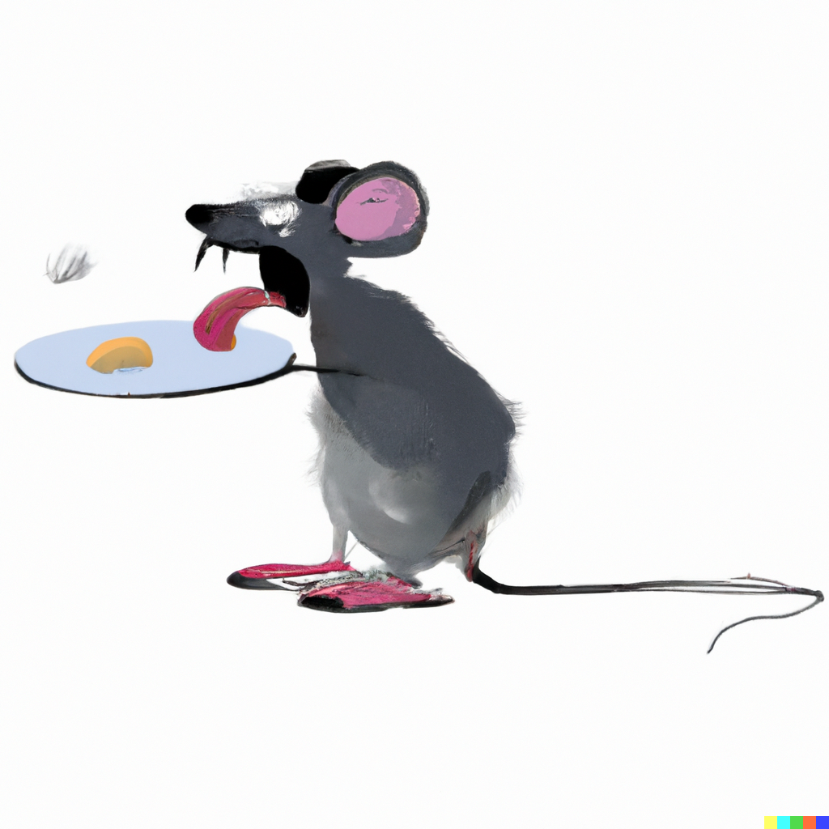


Feeling Of Hunger And Satiety
The sensation of hunger after a period of fasting and of satiety after eating is crucial to behavioral regulation of food intake
The biological mechanisms regulating these sensations are incompletely understood
Several studies on human subjects have shown that food is significantly more pleasant when they have fasted than under normal eating conditions.
Also, other studies on rodents demonstrated that rodents showed a significant increase in olfactory sensation after fasting

Slide 3
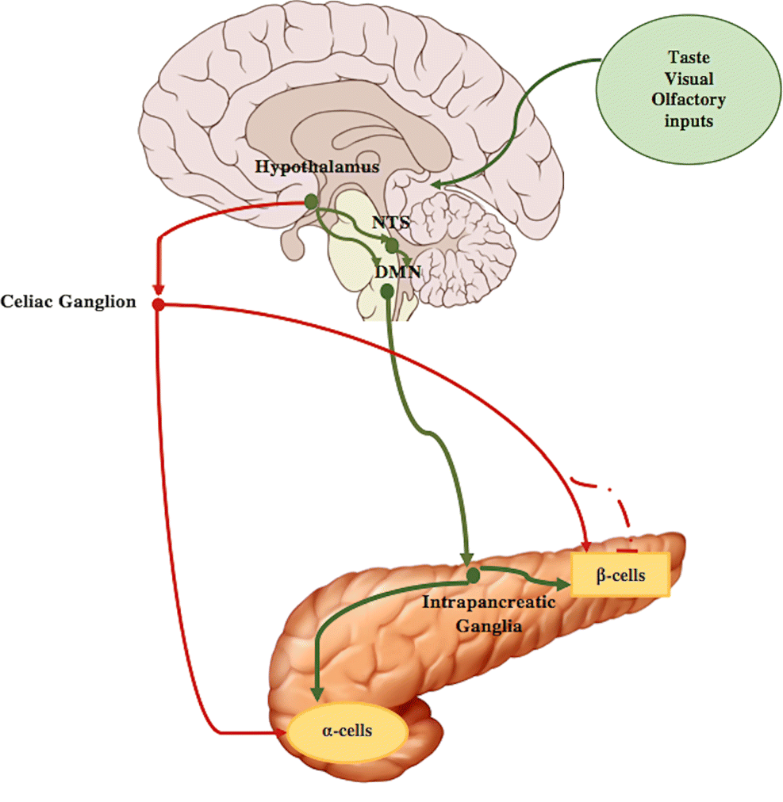
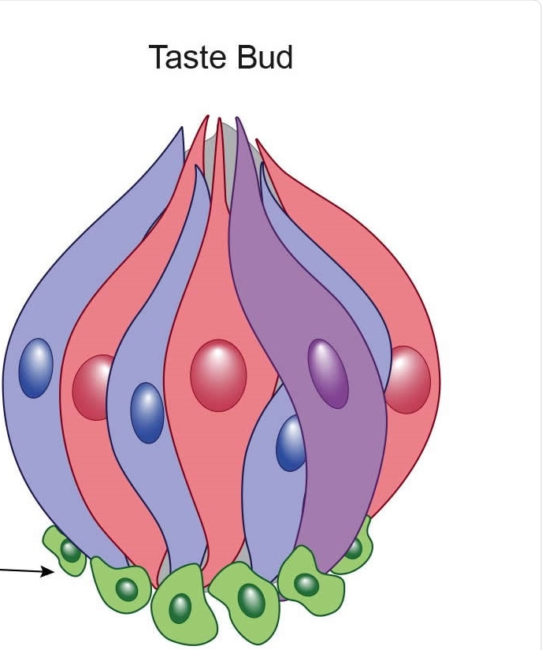
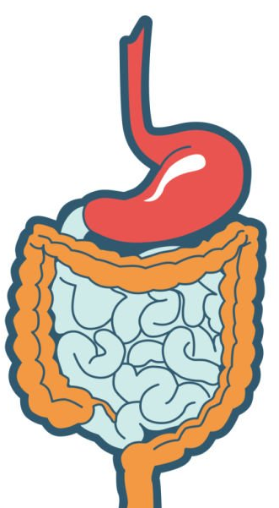
Gustatory system and Digestive System
The gustatory system and digestive system function in a synchronized manner and can influenced by each other during different phases of digestion.
Taste receptor cells express receptors for various peptides and hormones secreted during later digestion phases.

Slide 4
Experimental Design

Slide 5
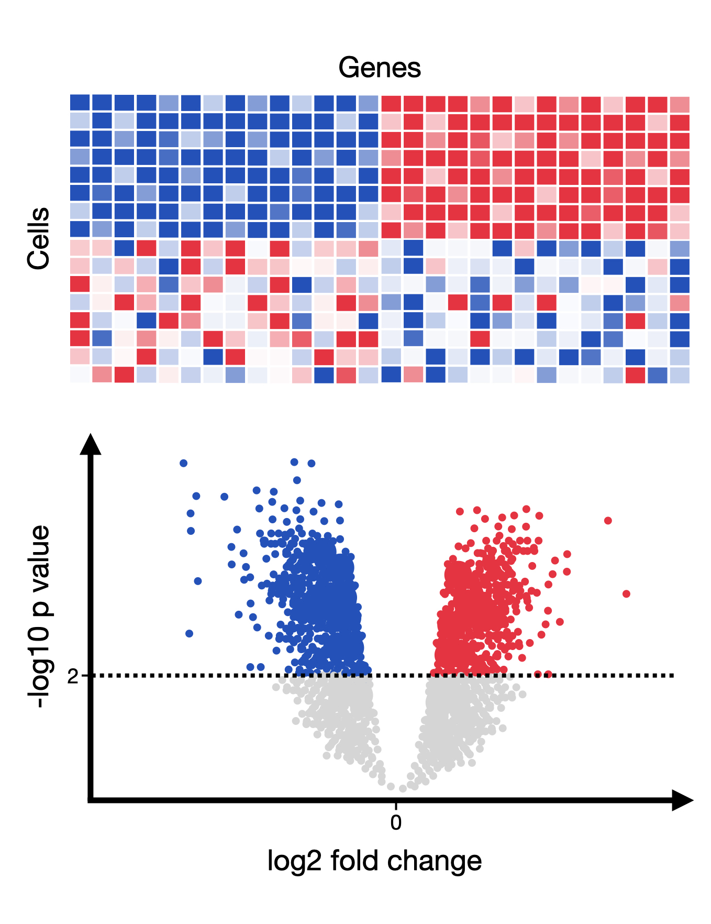
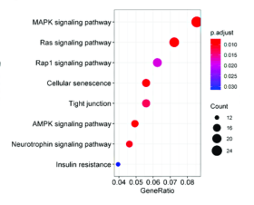
Expected Outcome
Identification of Differentially Expressed genes in Fasted and Fed groups
Identification of cellular pathways involving differentially expressed genes

